Slide 1
Algebra I
AIR Study Guide

Slide 2
Table of Contents
Topic | Slide | Topic | Slide
Formulas not on formula sheet | 3 | Polynomials | 20
What is Algebra | 4 | Systems of Equations | 21
Math Operator Vocabulary | 5 | FOIL (double distribution) | 22
Numbers, Numbers, Numbers | 6 | Factoring | 23
Absolute Value | 7 | Inequalities | 24
Proportions | 8 | Radicals | 26
Percent and Interest | 9 | Quadratics | 27
Properties | 10 | Parent Functions | 29
Solving Equations | 12 | Logic | 30
Functions | 13 | Sequences | 31
Slope/Rate of Change | 14 | Complex Fractions and Polynomials | 32
Graphing | 15 | Radical Equations | 34
Direct and Indirect Variation | 18 | Statistics | 35
Exponents | 19

Slide 3
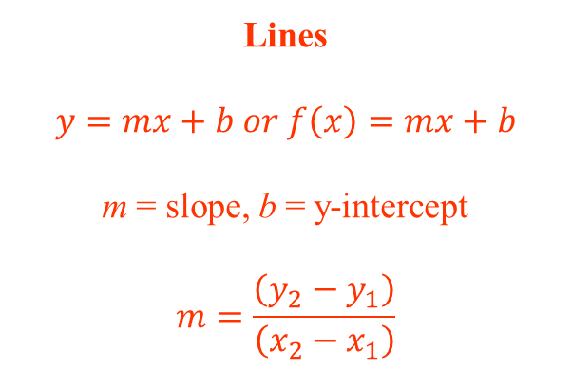
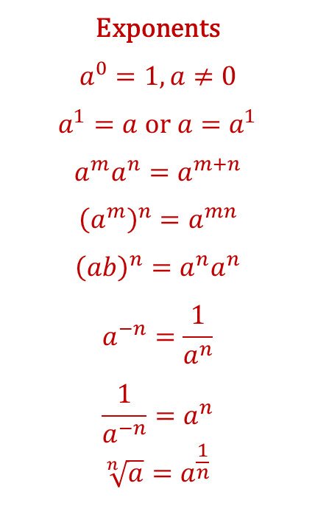
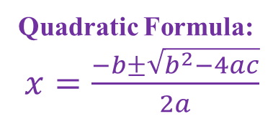
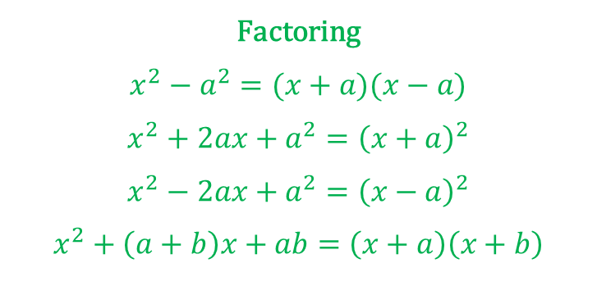
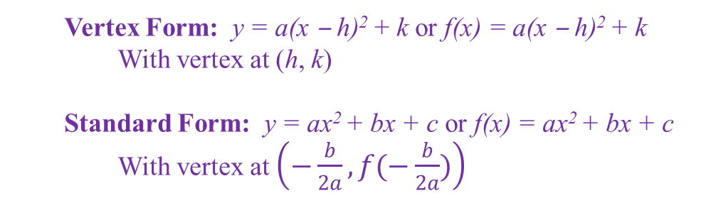
Formulas
(not provided on formula sheet)
Lines
$$y=mx+b or f\left(x\right)=mx+b$$
m = slope, b = y-intercept
$$m=\frac{\left(y_{2}−y_{1}\right)}{\left(x_{2}−x_{1}\right)}$$
Factoring
$$x^{2}−a^{2}=(x+a)(x−a)$$
$$x^{2}+2ax+a^{2}={\left(x+a\right)}^{2}$$
$$x^{2}−2ax+a^{2}={\left(x−a\right)}^{2}$$
$$x^{2}+\left(a+b\right)x+ab=\left(x+a\right)\left(x+b\right)$$
Exponents
$$a^{0}=1, a≠0$$
$a^{1}=a$ or $a=a^{1}$
$$a^{m}a^{n}=a^{m+n}$$
$${\left(a^{m}\right)}^{n}=a^{mn}$$
$${\left(ab\right)}^{n}=a^{n}a^{n}$$
$$a^{−n}=\frac{1}{a^{n}}$$
$$\frac{1}{a^{−n}}=a^{n}$$
$$\sqrt[n]{a}=a^{\frac{1}{n}}$$
Quadratics
Vertex Form: y = a(x ‒ h)² + k or f(x) = a(x ‒ h)² + k
With vertex at (h, k)
Standard Form: y = ax² + bx + c or f(x) = ax² + bx + c
With vertex at $\left(−\frac{b}{2a}, f(−\frac{b}{2a})\right)$
Quadratic Formula:
$x=\frac{−b±\sqrt{b^{2}−4ac}}{2a}$

Slide 4

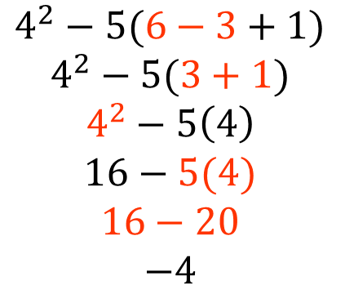
What is Algebra?
Order of Operations
Parenthesis ( ) [ ]
Exponents ² ³
Multiplication
Division
Addition
Subtraction
$$4^{2}−5(6−3+1)$$
$$4^{2}−5(3+1)$$
$$4^{2}−5\left(4\right)$$
$$16−5(4)$$
$$16−20$$
$$−4$$
* ( ) can represent multiplication when there is a number directly in front of the ( )—BEWARE!
from LEFT to RIGHT
from LEFT to RIGHT
Expressions
-just about anything without = sign
-vocabulary:
Terms: 5x², + 2x, – 3
Constant: – 3
Variable: x
Coefficients: 5, +2
$$5x^{2}+2x−3$$

Slide 5
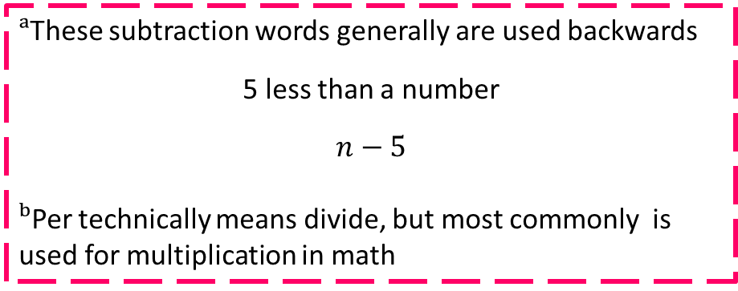
Math Operator Vocabulary
+ | − | × | ÷
Addition | Subtract | Times (more than) | Quotient
Add | Minus | Times (as many as) | Divided by
Sum | Difference | Multiply | Out of
Plus | Less (than)ᵃ | Of | Half (÷2)
More (than) | Decreaseᵃ | Product | Third (÷3)
Increase | Fewer (than) ᵃ | Twice ( ∙2) | Perᵇ
And (then) | Take away | Thrice ( ∙3)
Total |  | Each
 |  | Perᵇ
=
Is
Are
All together
Equal(s) to
Makes
ᵃThese subtraction words generally are used backwards
5 less than a number
$$n−5$$
ᵇPer technically means divide, but most commonly is used for multiplication in math

Slide 6
Numbers, Numbers, Numbers
Integers
Positives
+6
(same as addition)
Negatives
- 4, − 4
(negatives same as subtraction!)
Adding and Subtracting:
Positive team vs. Negative team
Winner: who has more players?
Answer: how many extra players?
*Simplify any “double signs” before doing
the problem, using rules for multiplication/division
Multiplying/Dividing:
Rules:
If you have one negative, KEEP the negative.
TWO negatives make a POSITIVE.
6 – 10 = ?
The negative team “wins” because they have 4 extra players, so 6 – 10 = -4
+ + → +
+ − → −
− + → −
− − → +

Slide 7
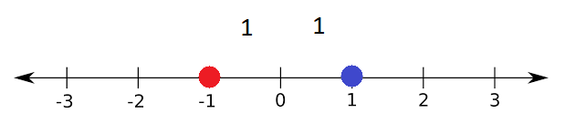

Absolute Value
How far away is it from zero?
Distance ALWAYS positive!
Notation:
$$\left|1\right|=1$$
and
$$\left|−1\right|=1$$
but
−$\left|1\right|=−1$
Because the negative is on the outside of the absolute value sign.

Slide 8
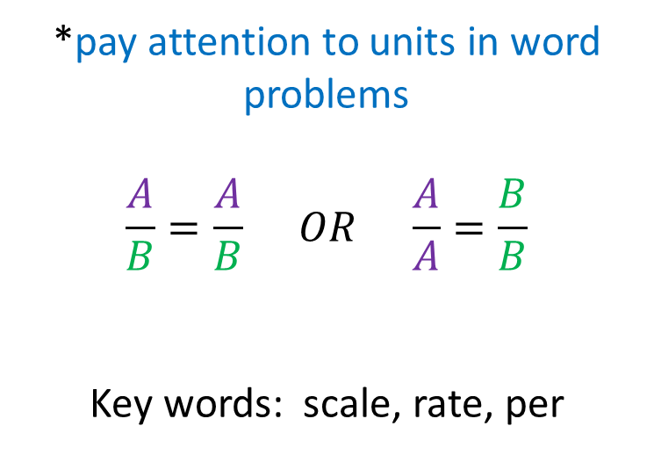
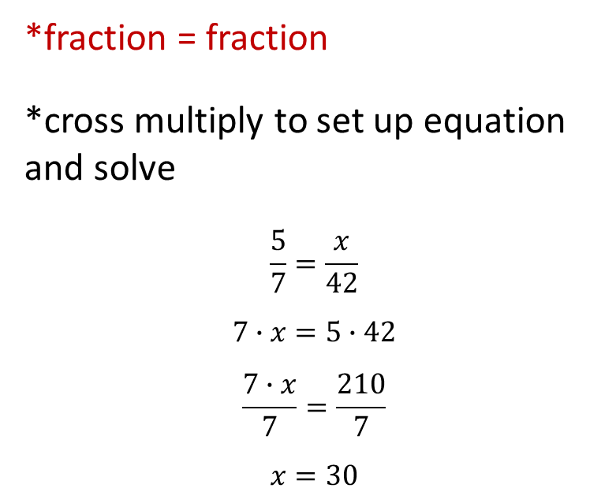
Proportions
*fraction = fraction
*cross multiply to set up equation and solve
$$\frac{5}{7}=\frac{x}{42}$$
$$7∙x=5∙42$$
$$\frac{7∙x}{7}=\frac{210}{7}$$
$$x=30$$
*pay attention to units in word problems
$$\frac{A}{B}=\frac{A}{B} OR \frac{A}{A}=\frac{B}{B}$$
Key words: scale, rate, per
The more complex the proportion is, the more complex the equation becomes!

Slide 9
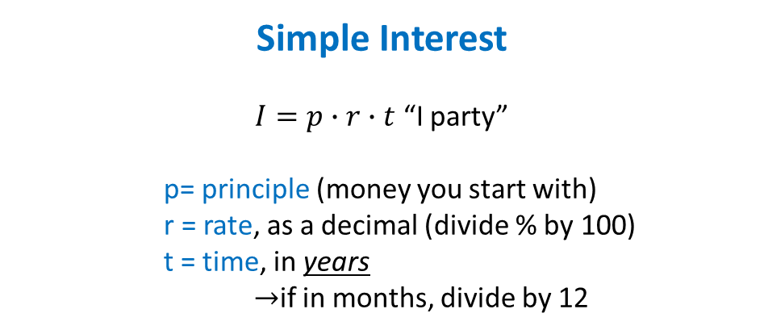
Percent and Interest
Percent: per 100
  *make sure you ANSWER the question (and it makes sense)!
% | Is/part
100 | Of/whole/total
+ | −
Tip | Discount | Off
Interest* | Sale | Reduced
Tax* | Interest* | Tax*
*solve like proportion*
*Not sure where to put the number?
Is it your percent/Does it represent your percent?
YES: top box (is/part)
NO: bottom box (of/whole/total)
*interest and tax may be added or subtracted given the scenario!
Simple Interest
$I=p∙r∙t$ “I party”
    p= principle (money you start with)
    r = rate, as a decimal (divide % by 100)
    t = time, in years
    →if in months, divide by 12
Percent of INCREASE or DECREASE
% | change
100 | original

Slide 10
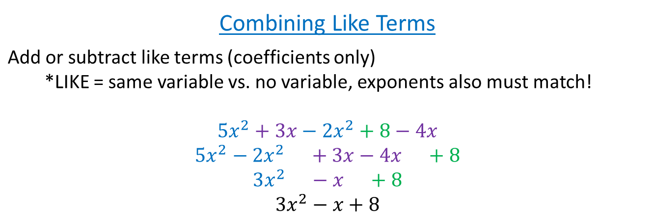
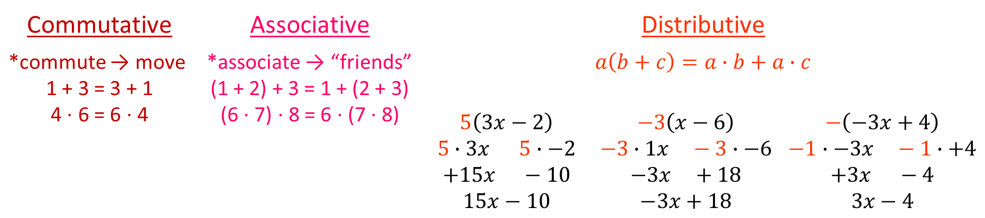
Properties
Commutative | Associative | Distributive
*commute → move 1 + 3 = 3 + 1 4 ⋅ 6 = 6 ⋅ 4 | *associate → “friends” (1 + 2) + 3 = 1 + (2 + 3) (6 ⋅ 7) ⋅ 8 = 6 ⋅ (7 ⋅ 8) | $$a\left(b+c\right)=a∙b+a∙c$$
 |  | $$5\left(3x−2\right)$$ $$5∙3x 5∙−2$$ $$+15x −10$$ $$15x−10$$ | $$−3\left(x−6\right)$$ $$−3∙1x −3∙−6$$ $$−3x +18$$ $$−3x+18$$ | $$−\left(−3x+4\right)$$ $$−1∙−3x −1∙+4$$ $$+3x −4$$ $$3x−4$$
Combining Like Terms
Add or subtract like terms (coefficients only) *LIKE = same variable vs. no variable, exponents also must match! $$5x^{2}+3x−2x^{2}+8−4x$$ $$5x^{2}−2x^{2} +3x−4x +8$$ $$3x^{2} −x +8$$ $$3x^{2}−x+8$$

Slide 11
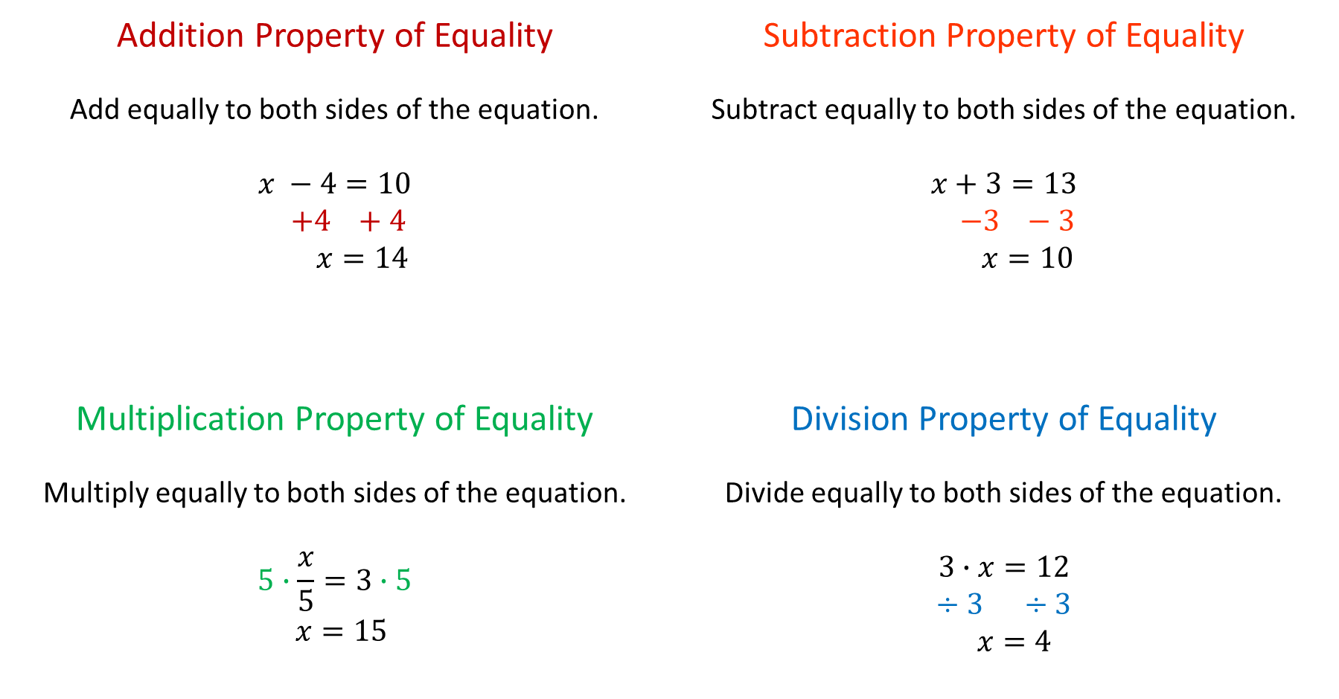
Properties, continued
Addition Property of Equality Add equally to both sides of the equation. $$x −4=10$$ $$+4 +4$$ $$x=14$$ | Subtraction Property of Equality Subtract equally to both sides of the equation. $$x+3=13$$ $$−3 −3$$ $$x=10$$
Multiplication Property of Equality Multiply equally to both sides of the equation. $$5∙\frac{x}{5}=3∙5$$ $$x=15$$ | Division Property of Equality Divide equally to both sides of the equation. $$3∙x=12$$ $$÷3 ÷3$$ $$x=4$$

Slide 12
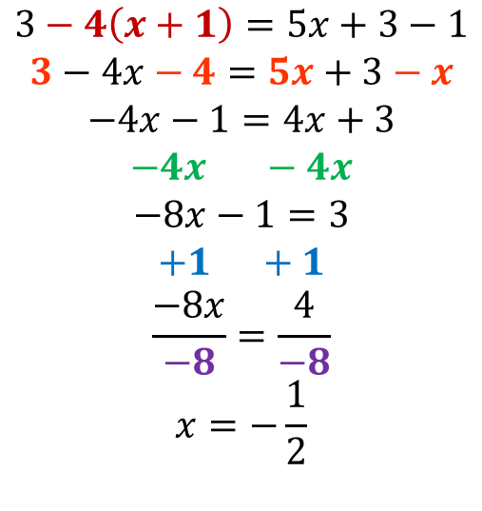
Solving Equations
Distribute on each side, if present.
Combine like terms on each side, if present.
Move variable terms to one side (if on both sides).
Move constant terms to other side.
Multiply or divide to get 1x
  *reminder 1x = x
Solutions:
One Solution
x = ___ (any number)
No Solution
5 = 10
(some false statement)
Infinite Solution
x = x or 10 = 10
(some true statement)
$$3−4\left(x+1\right)=5x+3−1$$
$$3−4x−4=5x+3−x$$
$$−4x−1=4x+3$$
$$−4x −4x$$
$$−8x−1=3$$
$$+1 +1$$
$$\frac{−8x}{−8}=\frac{4}{−8}$$
$$x=−\frac{1}{2}$$
Distribute
Combine like terms
Subtraction property of equality
Addition property of equality
Division property of equality

Slide 13
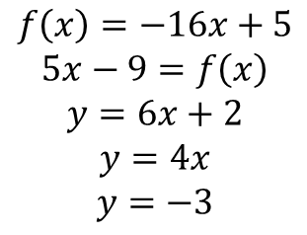
Functions
Look like:
1. Table 2. Rule 3. Graph
Input (x) | Output (y)
-3 | 6
-2 | 5
1 | 2
$$f\left(x\right)=−16x+5$$
$$5x−9=f\left(x\right)$$
$$y=6x+2$$
$$y=4x$$
$$y=−3$$
One input (x) cannot have two outputs (y)
>or< inputs must have consistent outputs
{(2,1), (4, 5), (3, 5)} is a function but
{(4, 5), (4, 6), (6, 3)} is not a function

Slide 14
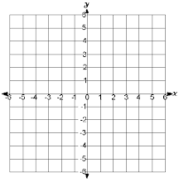
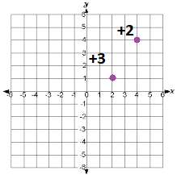
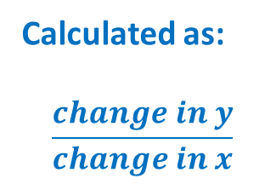
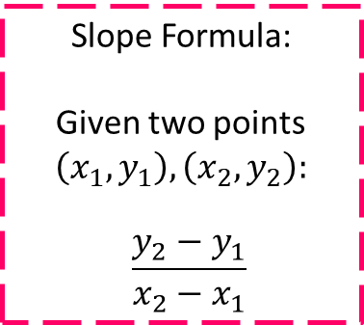
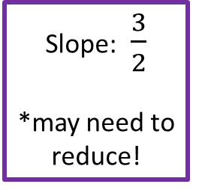
Slope/Rate of Change
Slope IS Rate of Change: the measured “slant” of a line
Positive Negative Zero Undefined
**read graphs from left to right!**
Calculated as:
$$\frac{change in y}{change in x}$$
Slope Formula:
Given two points $\left(x_{1}, y_{1}\right),\left(x_{2}, y_{2}\right):$
$$\frac{y_{2}−y_{1}}{x_{2}−x_{1}}$$
Slope: $\frac{3}{2}$
*may need to reduce!
up = positive
down = negative
right = positive
left = negative

Slide 15
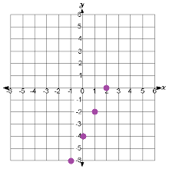

Graphing
Linear Functions (LINES)
Table **also useful for non-linear functions!**
Graph $y=2x−4$
Plug in your number for x
x | 2x – 4 | y
-2 | 2 ⋅ -2 – 4 | -8
-1 | 2 ⋅ -1 – 4 | -6
0 | 2 ⋅ 0 – 4 | -4
1 | 2 ⋅ 1 – 4 | -2
2 | 2 ⋅ 2 – 4 | 0
point (x, y)
(-2, -8)
(-1, -6)
(0, -4)
(1, -2)
(2, 0)
You choose,
keep it simple!

Slide 16
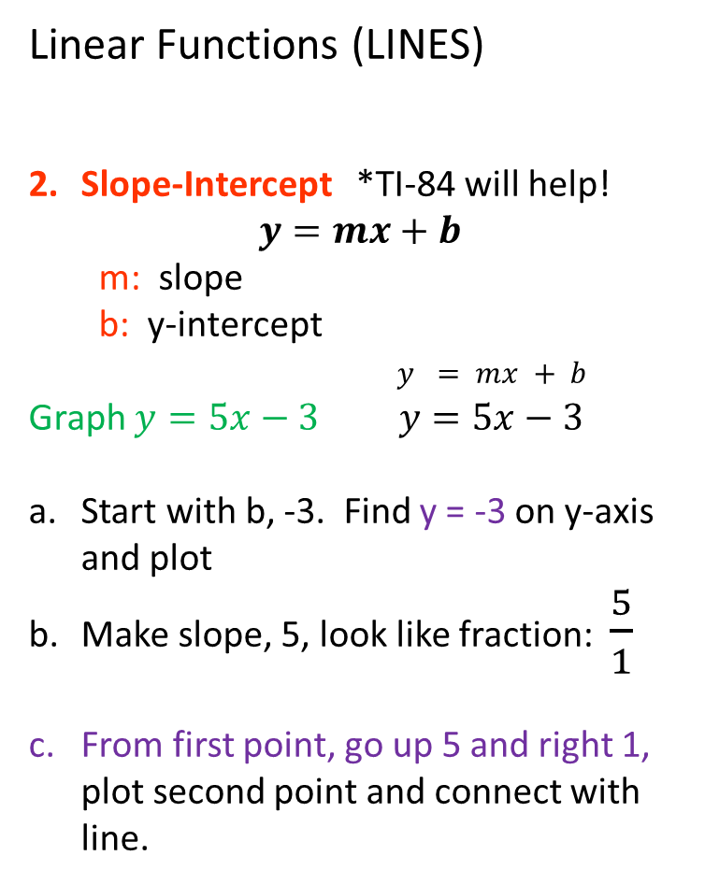

Graphing, part 2
Linear Functions (LINES)
Slope-Intercept *TI-84 will help!
$$y=mx+b$$
  m: slope
  b: y-intercept
$y = mx + b$
Graph $y=5x−3$ $y=5x−3$
Start with b, -3. Find y = -3 on y-axis and plot
Make slope, 5, look like fraction: $\frac{5}{1}$
From first point, go up 5 and right 1, plot second point and connect with line.
$$\frac{y}{x} \frac{"rise"}{"run"}$$
positive, up 5
positive, right 1

Slide 17
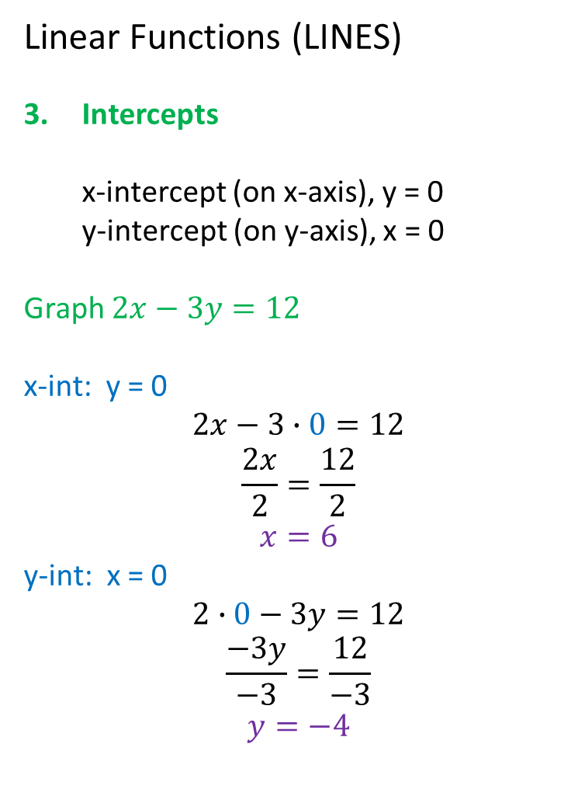


Graphing, part 3
Linear Functions (LINES)
Intercepts
  x-intercept (on x-axis), y = 0
  y-intercept (on y-axis), x = 0
Graph $2x−3y=12$
x-int: y = 0
$$2x−3∙0=12$$
$$\frac{2x}{2}=\frac{12}{2}$$
$$x=6$$
y-int: x = 0
$$2∙0−3y=12$$
$$\frac{−3y}{−3}=\frac{12}{−3}$$
$$y=−4$$
$$2x−3y=12$$
$$2x−3y=12$$

Slide 18
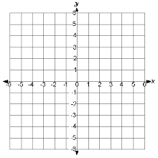
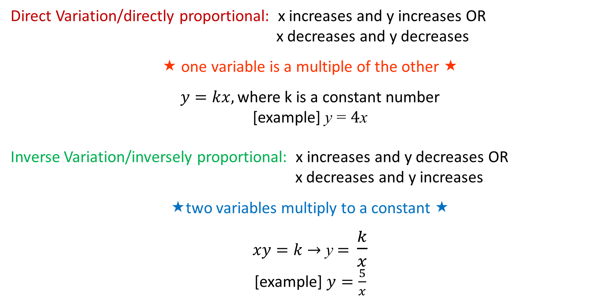
Direct and Indirect Variation
Direct Variation/directly proportional: x increases and y increases OR
x decreases and y decreases
★ one variable is a multiple of the other 
$$y=kx, \text{where} \text{k} \text{is} \text{a} \text{constant} \text{number}$$
[example] y = 4x
Inverse Variation/inversely proportional: x increases and y decreases OR
x decreases and y increases
two variables multiply to a constant 
$xy=k$ → y = $\frac{k}{x}$
[example] $y=\frac{5}{x}$

Slide 19
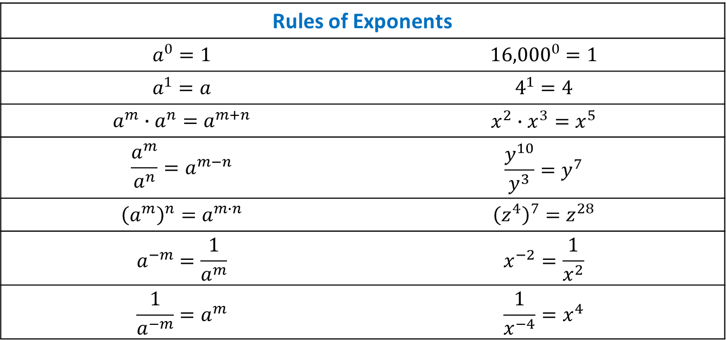
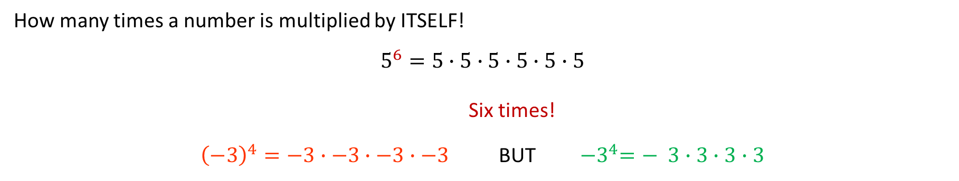
Exponents
How many times a number is multiplied by ITSELF!
$$5^{6}=5∙5∙5∙5∙5∙5$$
Six times!
${\left(−3\right)}^{4}=−3∙−3∙−3∙−3$ BUT ${−3}^{4}=− 3∙3∙3∙3$
Rules of Exponents
$$a^{0}=1$$ | $${16,000}^{0}=1$$
$$a^{1}=a$$ | $$4^{1}=4$$
$$a^{m}∙a^{n}=a^{m+n}$$ | $$x^{2}∙x^{3}=x^{5}$$
$$\frac{a^{m}}{a^{n}}=a^{m−n}$$ | $$\frac{y^{10}}{y^{3}}=y^{7}$$
$${\left(a^{m}\right)}^{n}=a^{m∙n}$$ | $${\left(z^{4}\right)}^{7}=z^{28}$$
$$a^{−m}=\frac{1}{a^{m}}$$ | $$x^{−2}=\frac{1}{x^{2}}$$
$$\frac{1}{a^{−m}}=a^{m}$$ | $$\frac{1}{x^{−4}}=x^{4}$$

Slide 20




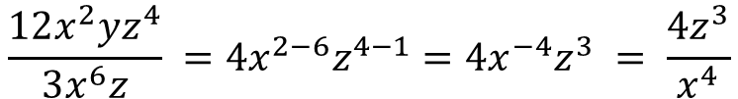
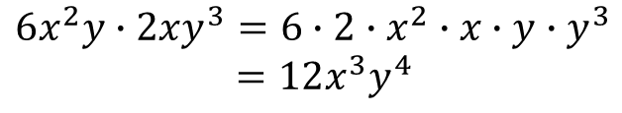
Polynomials
Add and Subtract: combine like terms
  *watch out for subtract → distribute – to all terms inside ( )
Multiply and Divide: use rules of exponents on like bases
$$\left(4x^{2}+3x−6\right)+\left(2x^{2}−6x+1\right)$$
$${4x}^{2}+2x^{2} +3x−6x −6+1$$
$$6x^{2} −3x −5$$
$$6x^{2}−3x−5$$
$$\left(4x^{2}+3x−6\right)−\left(2x^{2}−6x+1\right)$$
$${4x}^{2}−2x^{2} +3x−\left(−6x\right) −6−\left(+1\right)$$
$2x^{2} +9x −7$
$$2x^{2}+9x−7$$
$$3x+6x$$
$$6x^{2}y∙2xy^{3}=6∙2∙x^{2}∙x∙y∙y^{3}$$
$=12x^{3}y^{4}$
$$\frac{12x^{2}yz^{4}}{3x^{6}z} =4x^{2−6}z^{4−1}=4x^{−4}z^{3} = \frac{4z^{3}}{x^{4}}$$
$$x=x^{1}$$
$$y=y^{1}$$

Slide 21
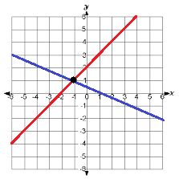
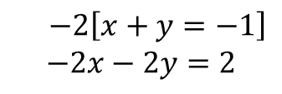
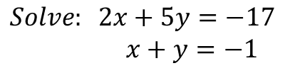
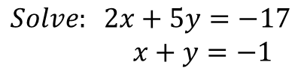
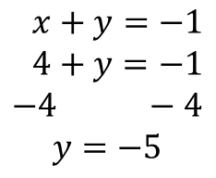

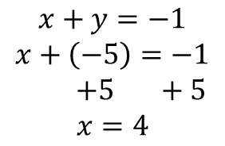
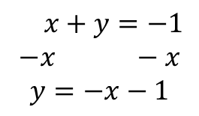
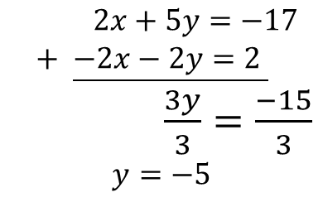
Systems of Equations
*system = more than one
*a solution of a system of equations is a point
How to Solve Systems of Equations
Graph (not best option because answer could be fraction, but TI-84 helps)
Substitution: get x or y= and plug into other equation
Addition/Elimination method: use distributive property and add equations to cancel a variable
The answer is here! (-1, 1), x = -1, y = 1
*if no solution, parallel lines; if infinite solutions,
the lines will be the same (on top of another)
3.
$$2x+5\left(−x−1\right)=−17$$
$$2x−5x−5=−17$$
$$−3x−5=−17$$
$+5 +5$
$$\frac{−3x}{−3}=\frac{−12}{−3}$$
$$x=4$$
4.
$x+y=−1$
$4+y=−1$
$$−4 −4$$
$$y=−5$$
$$Solve: 2x+5y=−17$$
$x+y=−1$
1.
$x+y=−1$
$$−x −x$$
$$y=−x−1$$
2.
2.
$2x+5y=−17$
$+ \underline{−2x−2y=2 }$
$\frac{3y}{3}=\frac{−15}{3}$
$$y=−5$$
3.
$$Solve: 2x+5y=−17$$
$x+y=−1$
1.
$$x+y=−1$$
$$x+\left(−5\right)=−1$$
$+5 +5$
$$x=4$$
$−2\left[x+y=−1\right]$
$$−2x−2y=2$$

Slide 22
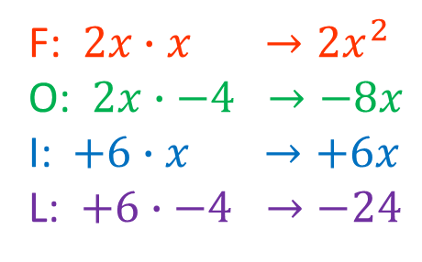

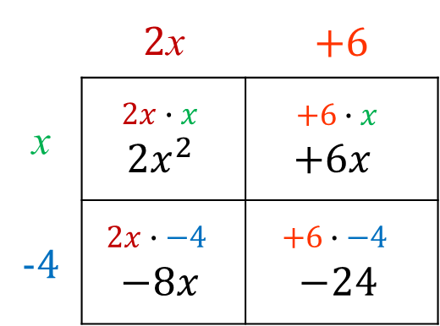

F.O.I.L. (double distribution)
First
Outer
Inner
Last
F: $2x∙x →2x^{2}$
O: $2x∙−4 →−8x$
I: $+6∙x →+6x$
L: $+6∙−4 →−24$
$$(2x+6)(x−4)$$
$$2x^{2}−8x+6x−24$$
$$2x^{2}−2x−24$$
Combine like terms!
Alternate method:
 | 2x | +6
x | $$2x∙x$$ $$2x^{2}$$ | $$+6∙x$$ $$+6x$$
-4 | $$2x∙−4$$ $$−8x$$ | $$+6∙−4$$ $$−24$$

Slide 23

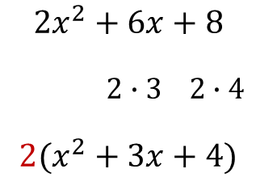



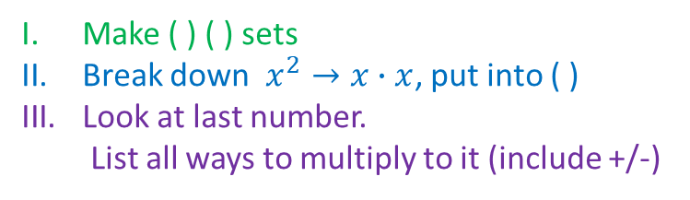

Factoring
*opposite of multiplication/distributing/FOIL
*get the ( ) back!
Look to see if all terms have a number and/or variable in common, pull out with division
If three terms, may need to factor into binomials
Be aware of special cases, found in the formulas section of this guide (slide __).
$$3x^{2}+6x$$
$$x∙x 2∙3$$
$$3x(x+2)$$
$$2x^{2}+6x+8$$
$$2∙3 2∙4$$
$$2(x^{2}+3x+4)$$
Make ( ) ( ) sets
Break down $x^{2}→x∙x$, put into ( )
Look at last number.
  List all ways to multiply to it (include +/-)
Look at list from step 3.
  Which will add to your
  middle number, -5?
  Fill in numbers in blanks
Factor:
$$x^{2}−5x+4$$
$$\left(x \right)\left(x \right)$$
-1 ⋅ -4 -1 + -4 = -5
+1⋅+4 +2 ⋅+2
-1 ⋅ -4 -2 ⋅ -2
$$\left(x−1\right)\left(x−4 \right)$$

Slide 24
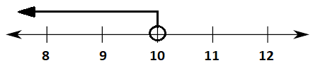








Inequalities
< > greater/less than
≤ ≥ greater/less than or equal to
*basic number line plots *compound
*absolute value
∘ for < >
⦁ for ≤ ≥
$$10>x$$
$$3≤x<6$$
x is bigger than or equal to 3 but less than 6
$$x≥6$$
$$−2≥x≥3$$
x is less than or equal to -2 but bigger than or equal to 3
$$\left|3x−12\right|≥6$$
$$−6≥3x−12≥6$$
$$+12 +12$$
$$\frac{6}{3}≥\frac{3x}{3}≥\frac{18}{3}$$
$$2≥x≥6$$
$$x≤2 or x≥6$$
1. Take answer and put before absolute value bars, but make answer negative.
Solve like a normal inequality, but on both sides at once!
  *remember to flip <, > when multiply/divide by a negative!
  *have two answers!!

Slide 25





Inequalities, part 2
Solving Linear Inequalities
Graphing Inequalities in Two Variables (coordinate plane)
Graph like normal line, BUT…
  < > dashed line - - - -
  ≤ ≥ solid line
Pick point not on line (x, y)
Plug point into inequality
  True: shade side with point
  False: shade opposite side
Systems of Inequalities
  Graph both inequalities together, where shading overlaps is solution!
When multiplying or dividing both sides of an inequality by a negative number, FLIP!
$$−3x+6>18$$
$−6 −6$
$$\frac{−3x}{−3}>\frac{12}{−3}$$
$$x<−4$$
$$y>2x+4$$
x y
Test point: (0, 0)
$$y>2x+4$$
$$0>2∙0+4$$
$$0>0+4$$
$$0>4$$
FALSE

Slide 26










Radicals
$$3^{2}=3∙3=9$$
$$4^{2}=4∙4=16$$
$$5^{2}=5∙5=25$$
$$6^{2}=6∙6=36$$
$$7^{2}=7∙7=49$$
$$8^{2}=8∙8=64$$
$$9^{2}=9∙9=81$$
$${10}^{2}=10∙10=100$$
$0^{2}=0∙0=$0
$$1^{2}=1∙1=1$$
$2^{2}=2∙2=$4
*mostly square roots
*square roots based on perfect squares
*when have square roots that are not perfect squares, need to see if there are any perfect square factors that can come “out” (simplify)
Simplify: $\sqrt{72}$
$$\sqrt{36∙2}$$
$$\sqrt{36}∙\sqrt{2}$$
$$6\sqrt{2}$$
Adding/Subtracting Radicals
  Can only add/subtract “like” radicals
  Simplify radicals to see if you have like radicals
Multiply/Divide Radicals
  Multiply or divide numbers outside radicals separately from inside radicals, simplify
$72$
$36∙2$
$$\sqrt{36}=6$$
$$7\sqrt{2}+6\sqrt{2}$$
$$7+6\sqrt{2}$$
$$13\sqrt{2}$$
$\sqrt{6}$ and $\sqrt{6}$ are like
$\sqrt{6}$ and $\sqrt{3}$ are not like
$$7\sqrt{2}∙6\sqrt{10}$$
$$7∙6\sqrt{2∙10}$$
→
→
$$42\sqrt{20}$$
$$84\sqrt{5}$$

Slide 27


Quadratics
*exponent of 2 on variable, graph looks like ∩ or ∪
*solutions = x-intercepts = zeros = roots
  *may not have any solutions if don’t cross x-axis
How to solve
*Graph: not very accurate unless using TI-84
*Factor: works on many quadratics, but not all
$$f\left(x\right)=x^{2}+5x+6$$
$$0=x^{2}+5x+6$$
$$0=(x+2)(x+3)$$
$$\left(x+2\right)=0 or \left(x+3\right)=0$$
$−2 −2 −3 −3$
$$x=−2 or x=−3$$
Square Root Method: if perfect square
$$\text{if} x^{2}=k$$
$$\text{then} x=±\sqrt{k}$$
$$x^{2}=16 → x=±\sqrt{16} → x=4, −4$$
Complete the Square: works for all
  *certain quadratics can be factored to ${\left(x+a\right)}^{2}$
  $$x^{2}+6x+9 → {\left(x+3\right)}^{2}$$
  *some quadratics are close: $x^{2}+6x+5$
  $$x^{2}+6x+5=0 \text{to} \text{solve} \text{for} \text{zeros}$$
  $+4 +4$
  $x^{2}+6x+9=4$
  ${ \left(x+3\right)}^{2}=4$ $\text{Use} \text{square} \text{root} \text{method}$
  $$(x+3)=±\sqrt{4}$$
  $\left(x+3\right)=2 or \left(x+3\right)=−2$
  $−3 −3 −3 −3$
  $x=−1 or x=−5$

Slide 28


Quadratics, part 2
How to solve, continued
Quadratic Equation: works for all, need formula
Given $f\left(x\right)=ax^{2}+bx+c$
Quadratic Equation: $x=\frac{−b±\sqrt{b^{2}−4ac}}{2a}$
*quadratic equation usually yields two answers
*will need to simplify your radical (if decimal is okay as answer, type in calculator)
$$f\left(x\right)=2x^{2}−9x+1$$
$$a=2, b=−9, c=1$$
$$x=\frac{−\left(−9\right)±\sqrt{{\left(−9\right)}^{2}−4∙2∙1}}{2∙2}$$
$$x=\frac{9±\sqrt{81−8}}{4}$$
Quadratic Inequalities:
Follow same rules for dashed/solid line and testing point as linear inequalities.
maximum: highest point
minimum: lowest point
$$x=\frac{9±\sqrt{73}}{4}$$
$x=\frac{9+\sqrt{73}}{4}$ or $x=\frac{9−\sqrt{73}}{4}$ (two answers)

Slide 29











Parent Functions
$$f\left(x\right)=x$$
$$f\left(x\right)=x^{2}$$
$$f\left(x\right)=\left|x\right|$$
$$f\left(x\right)=\sqrt{x}$$
$$f\left(x\right)=\frac{1}{x}$$
Transformations
$$f(x)±b$$ | Moves graph up (+) or down (-) b units. | $$f(x±b)$$ | Moves graph left (+) or right (-) b units.
$$a∙f(x)$$ | Stretches graph (a>1) or shrinks graph (a<1) vertically. x’s stay the same, y multiplied by a. | $$f(ax)$$ | Stretches graph (1/a) or shrinks graph (a) horizontally. x’s multiplied by 1/a, y stays same.
$$−f(x)$$ | Flips graph upside down (reflected over x-axis). | $$f(−x)$$ | Flips graph side to side (reflected over y-axis).

Slide 30

Logic
        If-Then (conditional) $p→q$
        Inverse $\sim p→\sim q$
        Converse $q→p$
        Contrapositive $\sim q→\sim p$
Truth values: Each p, q, ~p, ~q are assigned either true (T) or false (F) as a value.
An entire statement is considered true when…
Both parts are true
You start with false
All possible combinations | p | q | p → q
 | T | T | T
 | T | F | F
 | F | T | T
 | F | F | T

Slide 31




Sequences
Arithmetic: adds or subtracts a number to each term to get the next term
Geometric: multiplies a previous term by a number to get the next term
+2 +2 +2
1, 3, 5, 7, … find 100th term
n = 100
a = 1
d = 2
$$x_{100}=1+2(100−1)$$
$$x_{100}=1+2(99)$$
$$x_{100}=1+198$$
$$x_{100}=199$$
1, 3, 5, 7, …
$$x_{n}=a+d(n−1)$$
n = number of term (i.e. 9th term)
a = first term
d = common difference
⋅2 ⋅2 ⋅2
1, 2, 4, 8, … find 15th term
n = 15
a = 1
r = 2
$$x_{15}=1∙2^{(15−1)}$$
$$x_{15}=1∙2^{14}$$
$$x_{15}=1∙16384$$
$$x_{15}=16384$$
1, 2, 4, 8, …
$$x_{n}=ar^{(n−1)}$$
n = number of term (i.e. 9th term)
a = first term
r = common ratio (times what)

Slide 32









Complex Fractions and Polynomials
Add/Subtract: denominators MUST be same!
  Add/subtract numerators only, simplify if possible (may need to use factoring)
  What if denominators are different? Make same!
    *multiply to get common denominators
$$\frac{x}{x+4}+\frac{2}{x+4}=\frac{x+2}{x+4}$$
$$\frac{5x^{2}}{x−2}−\frac{10x}{x−2} = \frac{5x^{2}−10x}{x−2} = \frac{5x\left(x−2\right)}{x−2} = 5x$$
$$\frac{x}{x+4}−\frac{2}{x+1}$$
$$\frac{x(x+1)}{(x+4)(x+1)}−\frac{2(x+4)}{(x+4)(x+1)}$$
$$\frac{x^{2}+x−2x−8}{(x+4)(x+1)}$$
Common denominator: (x + 4)(x + 1)
$$\frac{x^{2}+x}{(x+4)(x+1)}−\frac{2x+8}{(x+4)(x+1)}$$
$\frac{x}{x+4}∙\frac{(x+1)}{(x+1)}−\frac{2}{x+1}$∙$\frac{(x+4)}{(x+4)}$
$$\frac{x^{2}−x−8}{(x+4)(x+1)}$$
$$\frac{x^{2}+x−(2x+8)}{(x+4)(x+1)}$$

Slide 33

Complex Fractions and Polynomials, part 2
Multiply/Divide: use rules of exponents
  * ÷ = multiply by reciprocal (flip)!
$$\frac{5x^{2}}{3yz}∙\frac{2y}{xz} = \frac{5∙2∙x^{2}∙y}{3∙x∙y∙z∙z} = \frac{10x^{2}y}{3xyz^{2}} = \frac{10x}{3z^{2}}$$
$$\frac{2x^{3}}{7yz}÷\frac{6y^{2}}{4xz} = \frac{2x^{3}}{7yz}∙\frac{4xz}{6y^{2}} = \frac{2∙4∙x^{3}∙x∙z}{7∙6∙y∙y^{2}∙z} = \frac{8x^{4}z}{42y^{3}z} = \frac{4x^{4}}{21y^{3}}$$

Slide 34


Radical Equations
*multiply ENTIRE equation by least common denominator!
*for variable denominators, choose “largest”
$$\frac{1}{x}+\frac{3}{2x}=10 LCD: 2x$$
$$2x\left[\frac{1}{x}+\frac{3}{2x}=10 \right]$$
$$2x∙\frac{1}{x}+2x∙\frac{3}{2x}=2x∙10$$
$$\frac{2x}{x}+\frac{6x}{2x}=20x$$
$$2+3=20x$$
$$\frac{5}{20}=\frac{20x}{20}$$
$$\frac{1}{4}=x$$
$$\frac{2x}{3}+\frac{x}{2}=\frac{5}{6} LCD: 6$$
$$6\left[\frac{2x}{3}+\frac{x}{2}=\frac{5}{6}\right]$$
$$6∙\frac{2x}{3}+6∙\frac{x}{2}=6∙\frac{5}{6}$$
$$\frac{12x}{3}+\frac{6x}{2}=\frac{30}{6}$$
$$4x+3x=5$$
$$\frac{7x}{7}=\frac{5}{7}$$
$$x=\frac{5}{7}$$

Slide 35








Statistics
Two-Way Frequency Tables
  -compares two types of data together
Correlation
  3 types
  *Correlation coefficient, r
$$−1≤r≤1$$
“How well data fits a line”
 | Car | Truck | Totals
Women | 65 | 15 | 80
Men | 35 | 45 | 60
Totals | 100 | 60 | 160
Sometimes the totals are not provided, but you can calculate!
positive
negative
no
r = 1 strong positive --------------------------------------------- r = 0 no ------------------------------------------- r = -1 strong negative

Slide 36
Statistics, part 2
Given a data set:
  Measures of Central Tendency—what number best represents the middle?
    Mean: “fair share” or average
    add all numbers together, divide by how many numbers
    Median: the physical middle
    put numbers in order smallest to largest
    if two, take mean of two middle numbers
    Mode: most frequent
  Measures of Dispersion—how spread out is the data?
    Range: highest number – lowest number

